Slide 1

Exploratory Data Analysis
G2M insight for Cab Investment firm
June 21st, 2022

Slide 2
Agenda
Problem Statement
Approach
EDA
EDA Summary
Recommendations

Slide 3
Problem Statement
XYZ is a private equity firm in US. Due to remarkable growth in the Cab Industry in last few years and multiple key players in the market, it is planning for an investment in Cab industry.
Objective :
EDA of given data with initial hypotheses;
Provide actionable insights to help XYZ firm in identifying the right company for making investment.
The analysis has been divided into four parts:
Data Pre-process and Understanding
Hypothesis
Data Analysis and Visualization
Results Related to the Hypothesis

Slide 4
Approach
Related Software: Python, Jupyter Notebook, Excel
Important Libraries: Numpy, Pandas, Matplotlib, datetime, locale
Important Functions: read_csv, merge, groupby, subplots, corr, etc.

Slide 5
EDA: Pre-processing and Understanding Data
Import data sets:
Given data sets: Cab_data.csv, City.csv, Customer_ID.csv, Transaction_ID.csv
Third-party data sets: Holiday.csv (Holidays from 2016 to 2018: 0 is not holiday, 1 means holiday)
Adjust data types:
Date of Travel: int -> datetime
Users: str -> int
Merge data sets into two DataFrames:
Cab_data.csv + Transaction_ID.csv + Customer_ID -> df1
City.csv + part of df1 data grouped by City -> df2
Add new columns:
For example: Revenue = Price Charged – Cost of Trip
Delete NaN Values

Slide 6
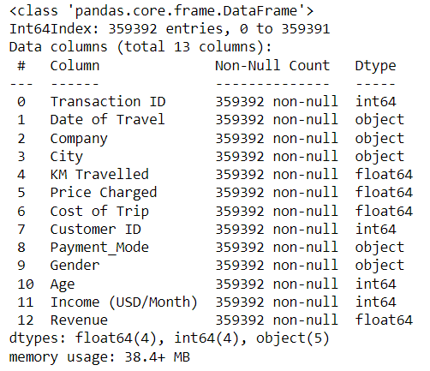
EDA: Pre-processing and Understanding Data
Summary of df1:

Slide 7
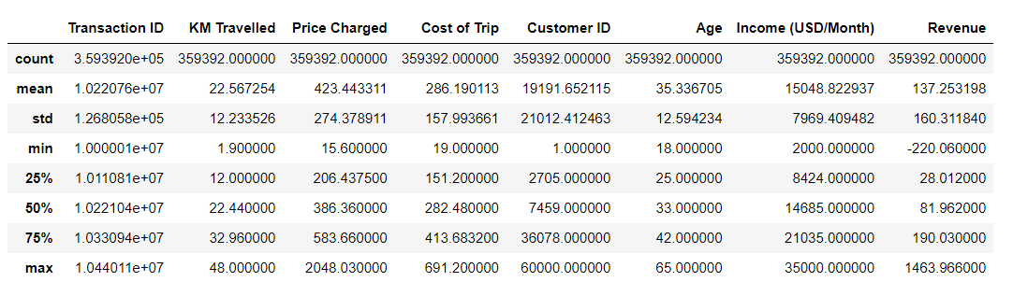
EDA: Pre-processing and Understanding Data
Summary of df1:

Slide 8
EDA: Hypotheses
In this analysis, there are 5 initial hypotheses related to cab companies and customers:
Hypothesis 1: Customer's age is related to the number of customers and average times of taking taxi.
Hypothesis 2: The more popular cab company is also more efficient in making revenues.
Hypothesis 3: The yearly and monthly patterns of the change of price per KM in the two companies are similar.
Hypothesis 4: In holidays customers tend to travel further than in normal days.
Hypothesis 5: The price of taxi in each city is related to number of users and customers' income.

Slide 9
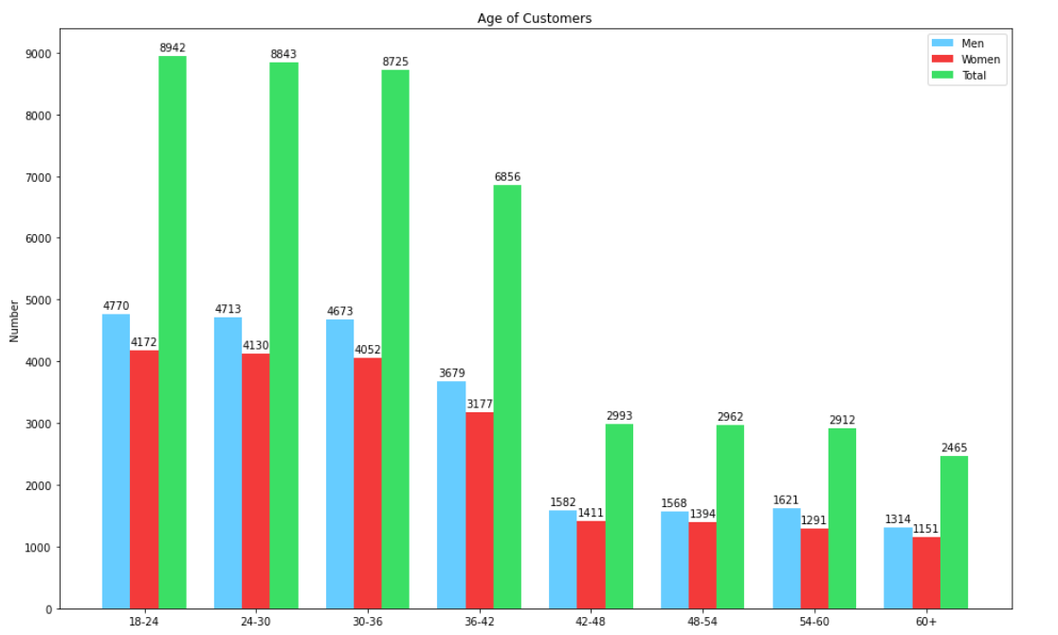
EDA: Hypothesis 1 - Age and Customer’s Number
Slight difference for men in 54-60 years old interval, but generally there are more customers in younger groups.
The difference is obvious between groups less than 42 years old and groups more than 42 years old.
The number of male customers is larger than that of female customers for each age group.

Slide 10
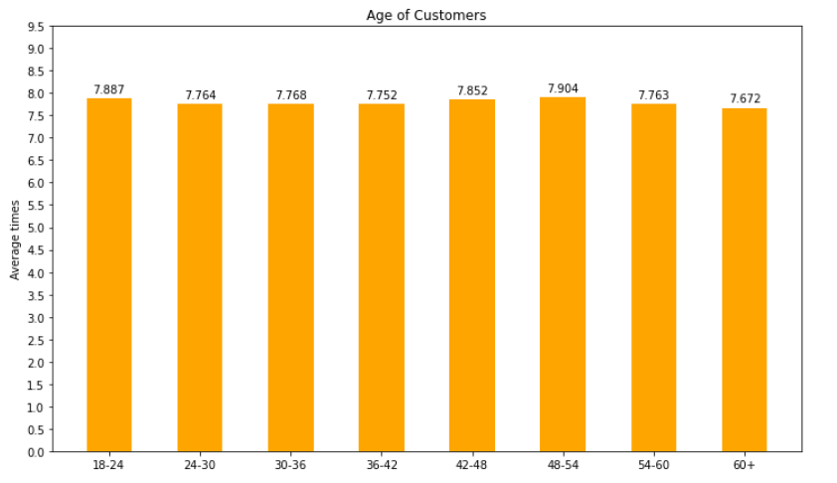

EDA: Hypothesis 1 - Age and Avg Times of Taking Taxis
From the graph, there are no significant difference in number of times of taking taxis among different groups.
The correlation value between age and the number of times is also extremely insignificant.

Slide 11
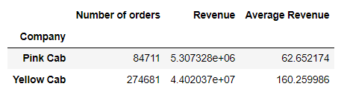
EDA: Hypothesis 2 – Overview of Two Cab Companies
Yellow Cab Company is more popular than Pink Cab Company, since it has much greater number of orders.
It also has more average revenue per order, which means that it is more efficient in making revenues than Pink Cab.
Guess of possible reasons:
Difference in the proportion of orders’ distances
Difference in the control of costs

Slide 12
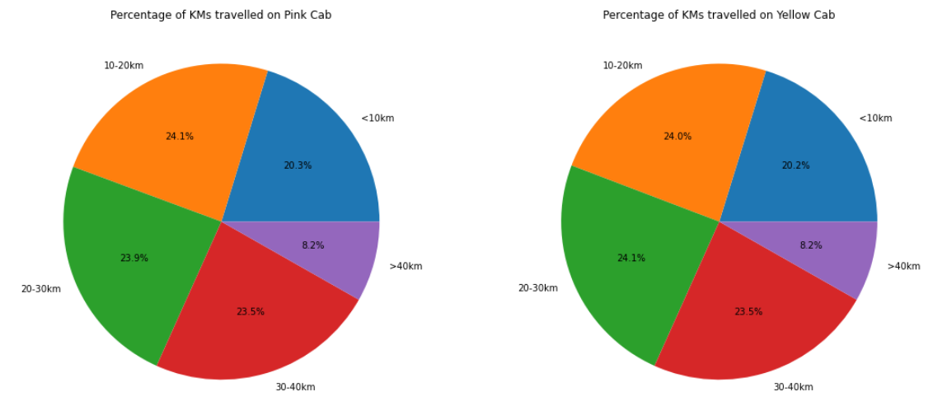
EDA: Hypothesis 2 – Comparison of Orders’ Distance
The percentage distribution of the two companies is almost the same, so the first guess can be excluded.

Slide 13

EDA: Hypothesis 2 – Comparison of costs’ proportion
The proportion of costs in the total prices charged is calculated and compared:
Result:
Yellow Cab Company has less cost proportion(65.0%) than Pink Cab Company(79.8%), so it’s possible that Yellow Cab has a relatively better control of costs, but further research is needed to fully verify the second guess.

Slide 14
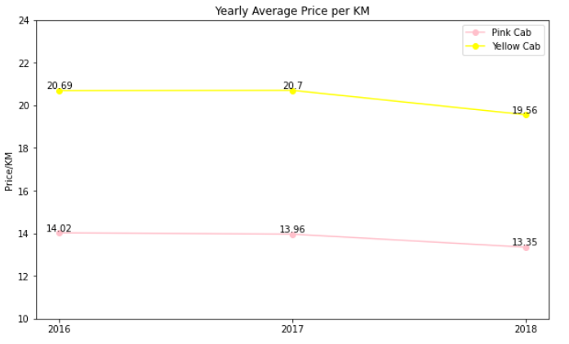
EDA: Hypothesis 3 – Yearly Average Prices Per KM
For each company, the average of prices per KM during each year is calculated and compared.
The two companies share similar pattern: the price does not change a lot from 2016 to 2017, but obviously decreased from 2017 to 2018.

Slide 15
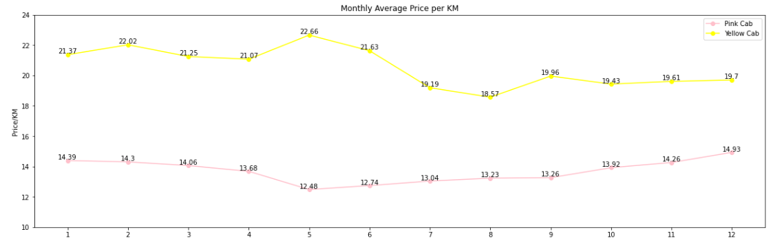
EDA: Hypothesis 3 – Monthly Average Prices Per KM
For each company, the average of prices per KM during each year is calculated and compared.
The trends of two line are different, and from April to August the trends are significantly opposite.

Slide 16

EDA: Hypothesis 3 – Monthly Average Prices Per KM
Although the correlation is not strong enough, we can conclude that the trends are weakly negatively related, which is the same as the obvious pattern between April and August.

Slide 17
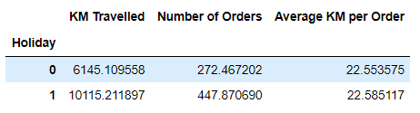
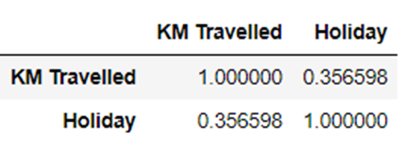
EDA: Hypothesis 4 – Travel Distances and Holidays
There are more orders and further distance travelled in holidays.
However, the average distance per order are very close, and the difference is not large enough to prove the hypothesis.
To further check this, the correlation between travel distance and holiday was calculated (next page).
The two variables are positively weakly correlated, which seems like a good support of the hypothesis.

Slide 18
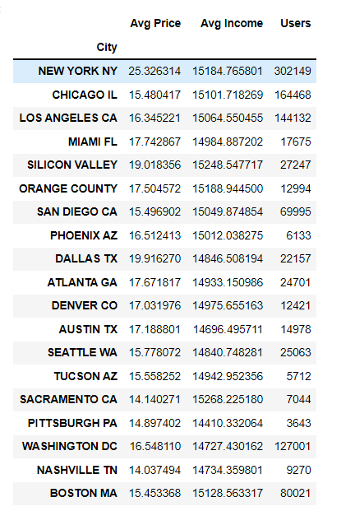
EDA: Hypothesis 5 – Overview of 3 factors

Slide 19
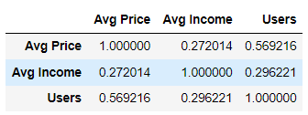
EDA: Hypothesis 5 – Correlations
The number of users are significantly positively related to average price.
Average income is weakly positively related to average price.
The correlation between users and average price is not large enough, we can not sure whether they are related.

Slide 20
EDA Summary
Customer's age is related to the number of customers, but not related to average times of taking taxis.
The more popular cab company(Yellow Cab) is also more efficient in making revenues, and one possible factor is the control of costs.
The yearly pattern of the change of price per KM in the two companies are similar, but the monthly pattern in the two companies are likely the opposite.
In holidays customers tend to travel further than in normal days.
The price of taxis in each city is related to customers' income, and is weakly related to the number of users.

Slide 21
Recommendation
From the analysis, the recommendation of cab company is Yellow Cab Company, based on three main reasons:
More popularity across the country;
More revenue from each order;
Better control of costs.

Slide 22

Thank You !

